Slide 1
Cyber Attack Research Report
WannaCry Ransomware Attack (2017)
Submitted by-
Ashish Chandel

Slide 2
Agenda
Introduction to Cyber Attacks
What is Ransomware?
Introduction to WannaCry
Origin: The EternalBlue Exploit
Technical Working of WannaCry
Ransom Message (Visual)
Global Impact and Map
Targeted Sectors
SMB Vulnerability Explained
Kill Switch Discovery
Microsoft Response
Prevention and Cyber Hygiene

Slide 3
Introduction to Cyber Attacks
Cyber attack is a malicious activity that steal data,invade privacy and disrupt system.
Types of Cyber Attacks:
Malware
Phishing
Denial of Service (DoS)
Man-in-the-Middle (MITM)
Ransomware

Slide 4
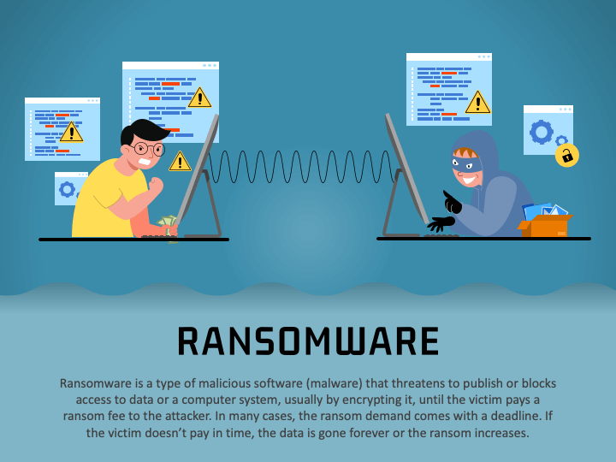
What is Ransomware
Ransomware is a type of malicious software that encrypts files on a victim’s system and demands a ransom to restore access.
How it Works:
Malware infects the system
Files are locked with encryption
A ransom note appears, demanding payment (usually in Bitcoin)

Slide 5
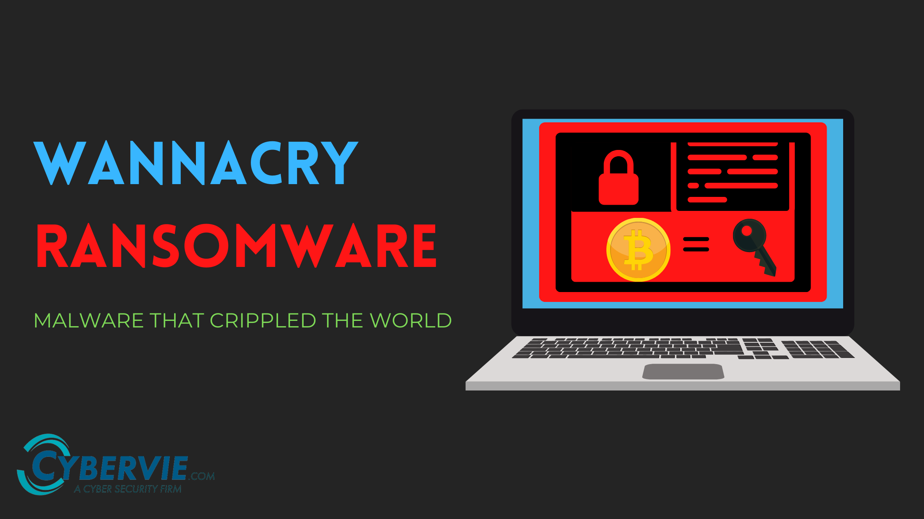
WannaCry Ransomwar
WannaCry is a ransomware attack that occurred in May 2017
It encrypted files on Windows computers and demanded a Bitcoin ransom
Exploits a vulnerability in Windows SMBv1 protocol
Attacker used the EternalBlue exploit, allegedly stolen from the NSA

Slide 6
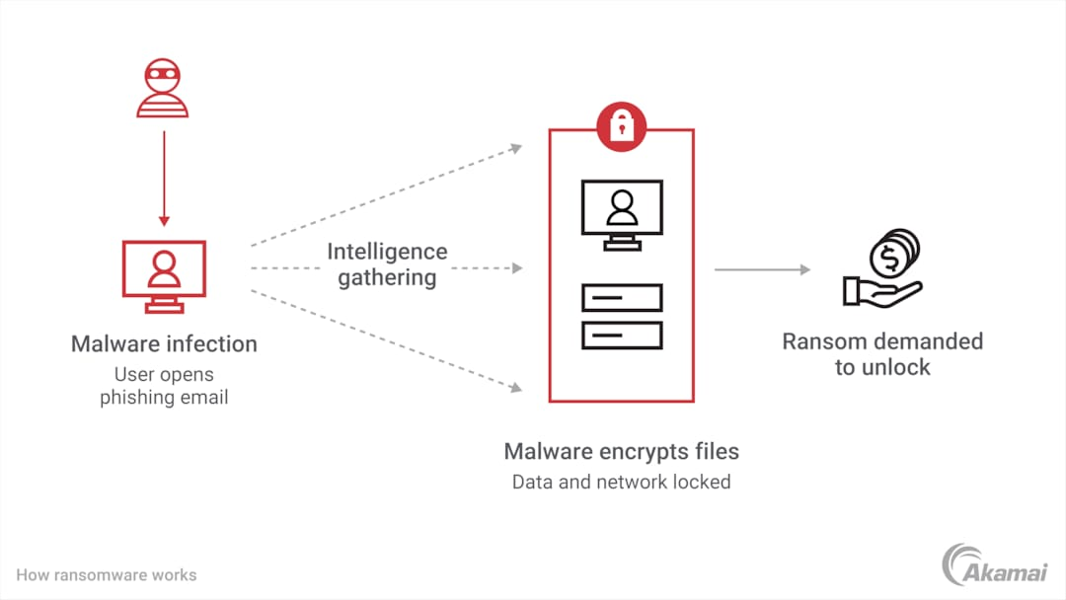

Slide 7
Origin of WannaCry – EternalBlue Exploit
EternalBlue is a cyber exploit developed by the U.S. NSA
Leverages a flaw in Microsoft SMBv1 protocol
Leaked publicly by hacker group Shadow Brokers in April 2017
Exploits port 445 to gain remote code execution
No user action needed – works automatically on unpatched systems

Slide 8
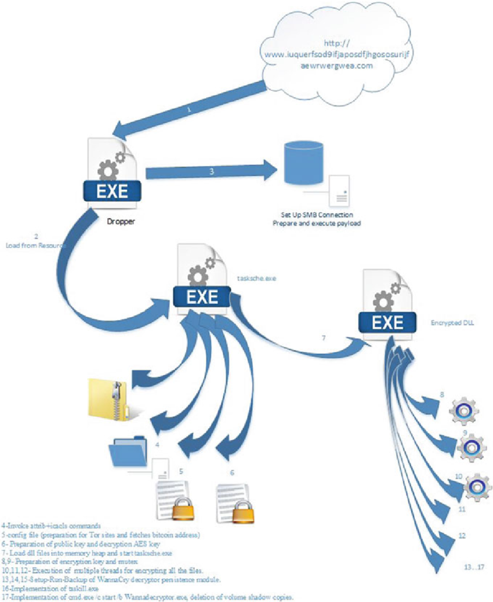
working of wannacry
Malware enters via EternalBlue exploit
Drops two files: tasksche.exe (spreader), wnry.exe (encryptor)
Encrypts personal files: .doc, .jpg, .mp4, etc.
Shows ransom note in multiple languages
Demands payment in Bitcoin (~$300–$600)

Slide 9
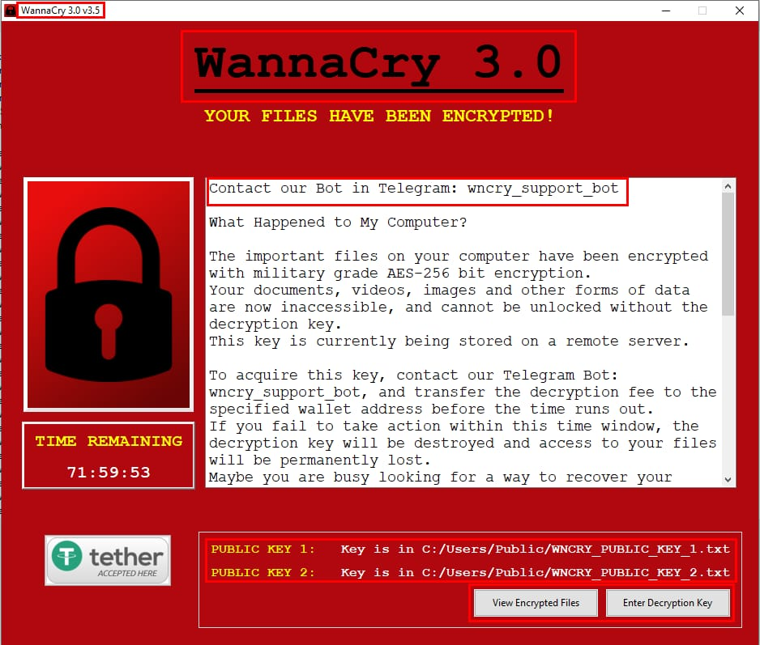
Ransom message (visual)

Slide 10
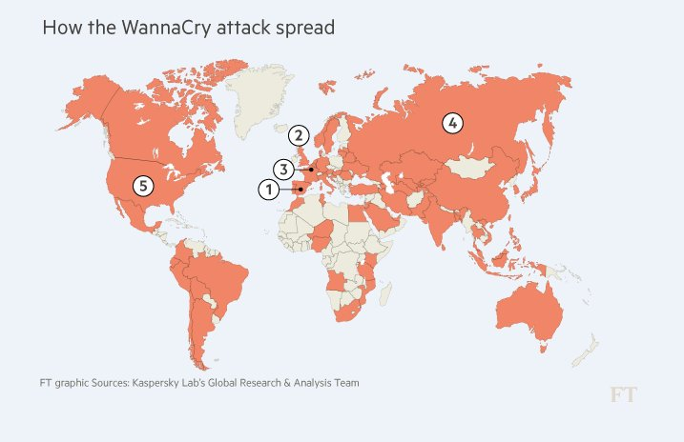

Slide 11
Targeted Sectors
Public health (NHS – UK)
Transportation (Indian Railways)
Telecom (Spain’
Banking systems
Government agencies
Universities and educational institutes

Slide 12
SMB Vulnerability Explained
SMB (Server Message Block) is used for file sharing in Windows
WannaCry targeted SMBv1 protocol, a legacy system
Exploited port 445 to send malicious packets
Vulnerability identified as CVE-2017-0144
Microsoft patched it in March 2017 (MS17-010)
Many users failed to update — led to mass infection

Slide 13
Kill Switch Discovery
Security researcher Marcus Hutchins (MalwareTech) discovered a kill switch
Found an unregistered domain inside the WannaCry code
He registered the domain, which stopped the malware from spreading
The domain acted as a check — if active, WannaCry shut down
This accidentally saved millions of systems worldwide

Slide 14
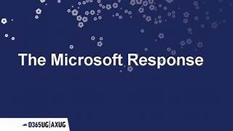
Microsoft Response
Released patch MS17-010 in March 2017 (before attack)
Issued emergency patches even for outdated OS versions (XP, 2003)
Urged users to disable SMBv1 and update OS
Encouraged regular backups and use of modern antivirus
Later updates added SMBv1 auto-disable in newer Windows versions

Slide 15
Prevention and Cyber Hygiene
Keep operating systems up to date (install patches regularly)
🔐 Disable SMBv1 protocol on all systems
🧪 Use strong, updated antivirus and anti-malware tools
🧬 Enable firewalls and block unused ports (like port 445)
☁️ Maintain regular backups of important data
🧠 Educate employees/users about phishing and suspicious links

Slide 16
Thank You!

